Slide 1

ANATOMY: CO₂

Slide 2
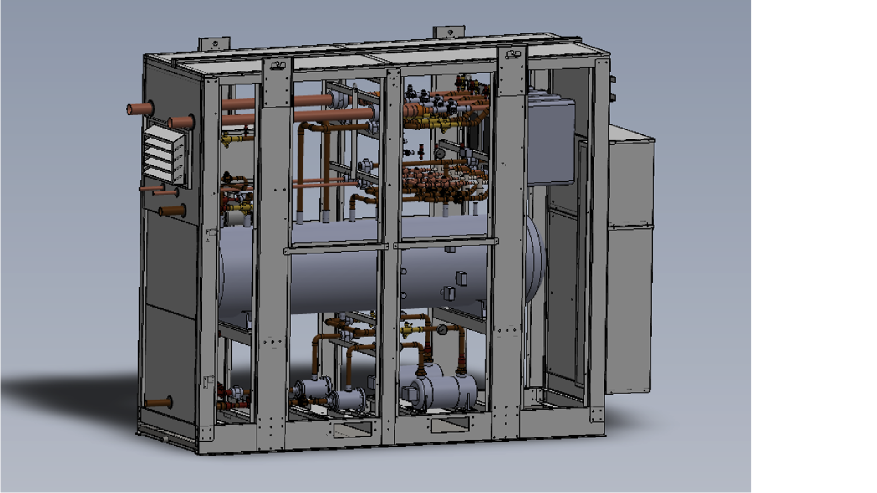

ANATOMY: CO₂

Slide 3
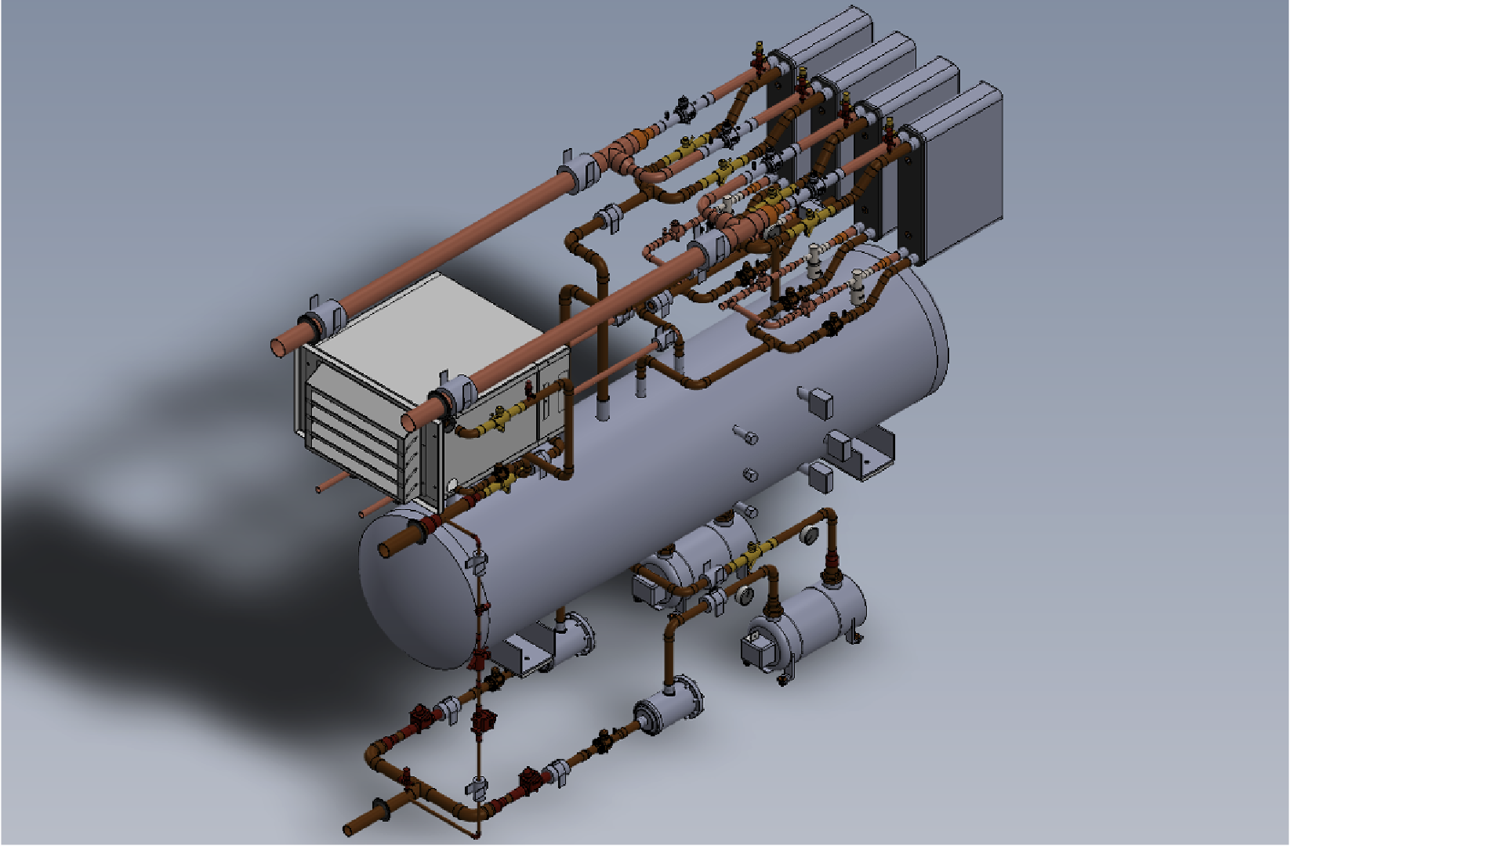
ANATOMY: CO₂

Slide 4
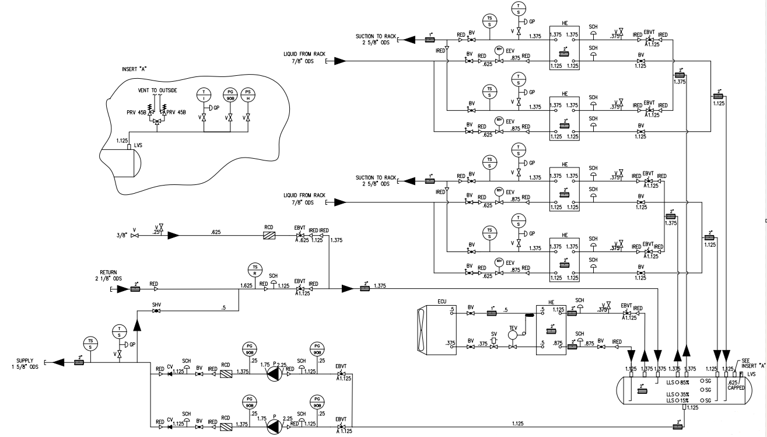
Overview: CO₂ P&ID
Notes:
Start at vapor separator, then Heat exchangers, pumps, driers, valves, ECU, refrigeration side,

Slide 5
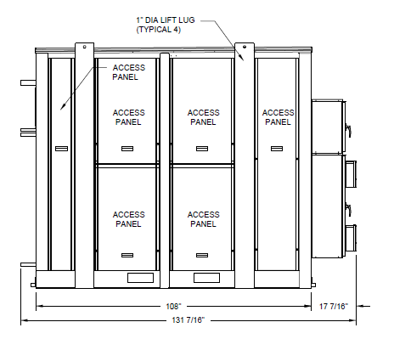
Mounting & Installation
Full perimeter curb support recommended
Stainless Steel removeable catch pan provided
  ¾” connection one side only
  Flat construction
Lifting lugs installed
Notes:
Catch pan can be oriented either direction for installation

Slide 6
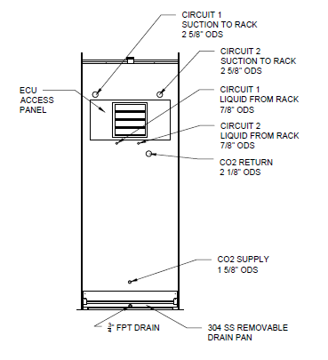
Piping
K65 XHP Copper-Iron alloy piping
ODS Connections
2” Armaflex™ insulation
on CO₂ piping

Slide 7
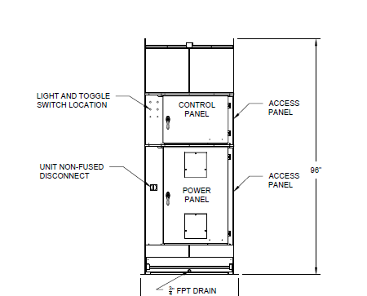
Power and Control
Control Enclosure
  All low voltage (24V)
  External indicator lights
  Carel™, Emerson™ EXD, UPS, etc.
Power Enclosure
  Anything greater than 24V
  Power entry, transformers, panel heater, VFD, etc.
  External disconnect provided

Slide 8
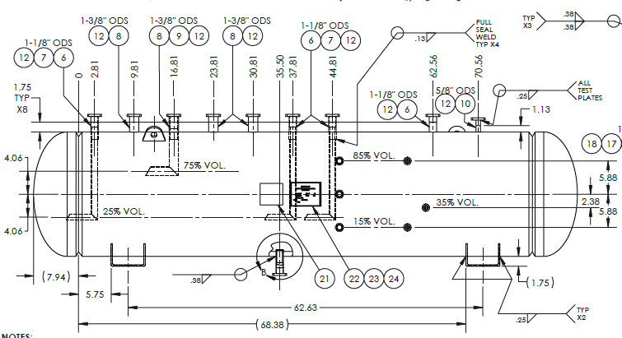
Liquid Vapor Separator
Thermosiphon function
Liquid level switches
    15, 35, and 85%
Sight glasses
    15, 50 and 85%
Pressure control
    Carel ™ pressure transducer
    Danfoss ™ pressure switch
Dual PRV with changeover valve for service
    Set for 45 bar
    Vent external

Slide 9
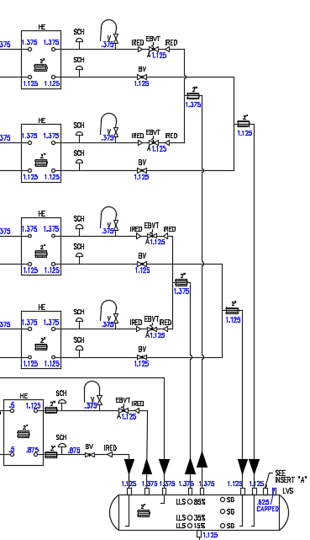
Heat Exchangers
Four (4) individual single circuit brazed plate exchangers
Ability for four (4) capacity steps

Slide 10
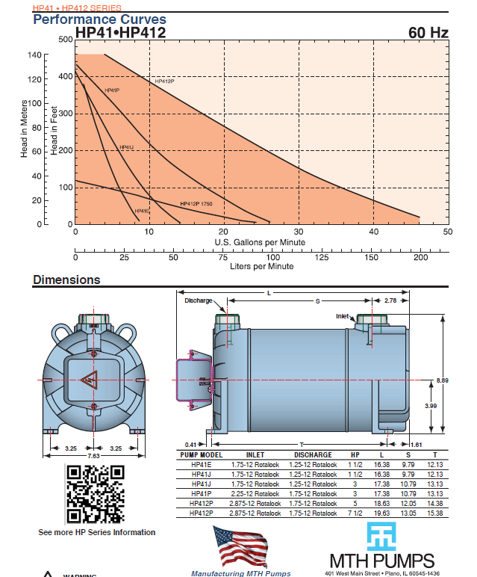
Pumps
Regenerative Turbine Pump
  Reduces NPSHr and allows for high head / low flow application
Run/Stand-by design
Speed set by VFD based on specific store application
  Designed for 1-10 GPM with adjustable bypass

Slide 11
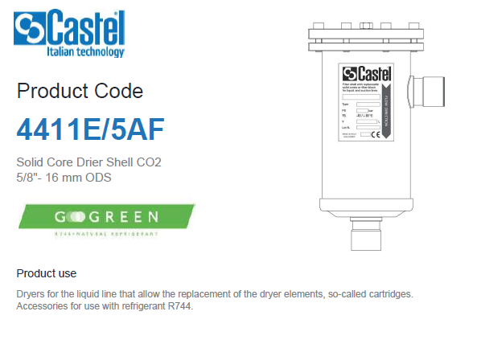
Liquid Filter Driers
Replaceable core
Anti-Acid cores to
limit carbonic acid
formation
Additional filter on
charge line
Notes:
Used on both charge line and pumped fluid line

Slide 12
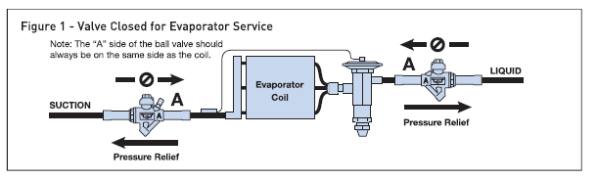
Ball Valves with Internal Pressure Relief
Ball valves with internal pressure relief strategically placed throughout the system to relieve pressure back to LVS
Valves function as isolation valve for basic service requirements
Will relieve
excess pressure
in specified
direction in
instance of
trapped liquid
CO₂

Slide 13
Expansion Valves
Four (4) Emerson™ EXV Valves
  Wide capacity range covers 448a/404a and 407a
Dual Emerson™ EXD Superheat controllers
  Each Controller controls one (1) complete circuit
  ECP-024 UPS provided to close expansion valves if battery backup power runs down

Slide 14
ECU: Emergency Condensing Units
Powered by separate battery/inverter system
Single brazed plate heat exchanger
Mechanical TXV
Factory charged with 3 lbs R448a
Will enable under high system pressure
  40 bar pressure switch (reset at 30 bar)
  Adjustable setting under Carel™ Control (28 bar)
  Cartridge-style installation for ease of service
Can be enabled to decrease charge time

Slide 15
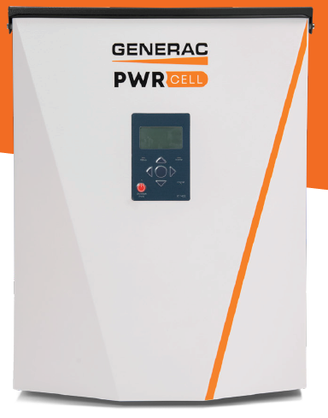
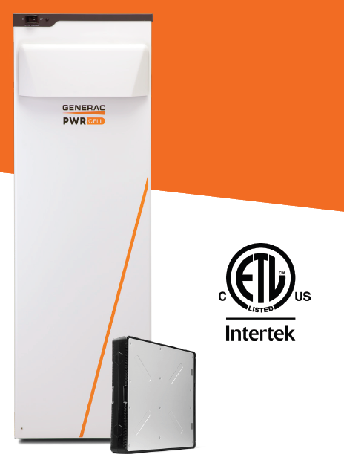
Generac ™ Battery Back-up
PWRcell ™ Inverter and Battery
  240/1/60 incoming power
  Remote stop switch located at skid – Contractor wired.
  Battery engages when main power is lost
  Provides emergency power
    ECU
    Carel ™ Controller
    Emerson ™ EXD Controller
  Must be mounted in climate-controlled environment.
(3) Battery Modules.
9 kWh of usable energy.
3.4 kW of nominal continuous AC power.

Slide 16
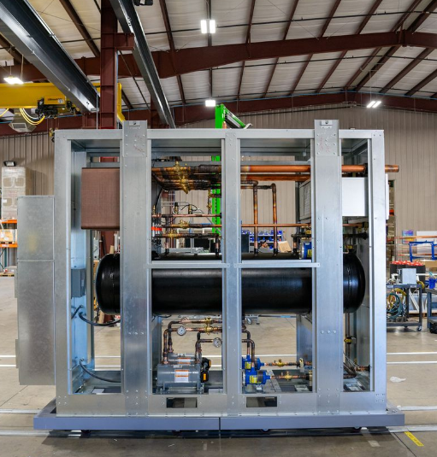
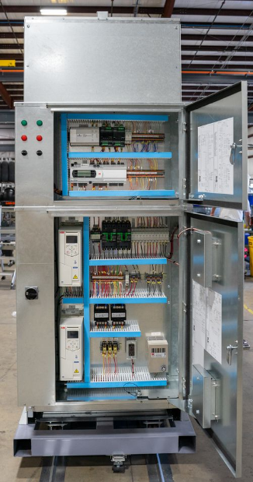
Insulation
All refrigerant and CO₂ piping is insulated with
2” thick closed cell foam insulation to minimize condensation

Slide 17
END OF ANATOMY: CO₂

Slide 18
APPLICATION: CO₂

Slide 19
What are we Doing?
State, Federal and Global regulation is driving industry change.
  Walmart’s decarbonization
  initiative to reduce greenhouse
  gas emissions by
  1B Metric Tons from
  global value chain by
1B MT
2030.

Slide 20
How does our equipment align with this initiative?
90%+
Reducing the HFC refrigerant volume by
Replacing existing refrigerants with R448a that has a Global Warming Potential (GWP) of 1397 compared to R407a at a 2100 and R404a at 3920. (GWP of CO₂ = 1)
at each store

Slide 21
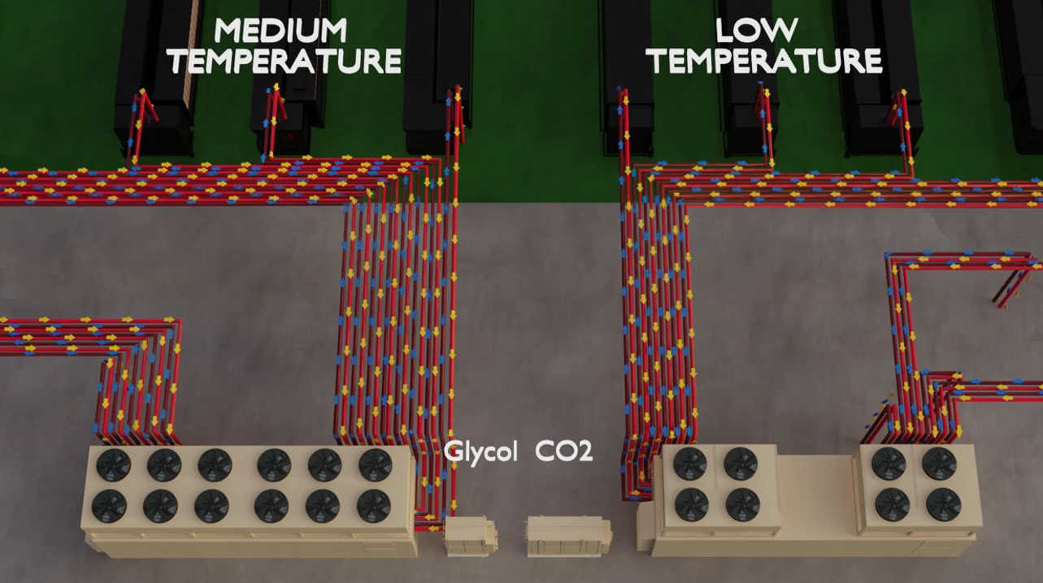
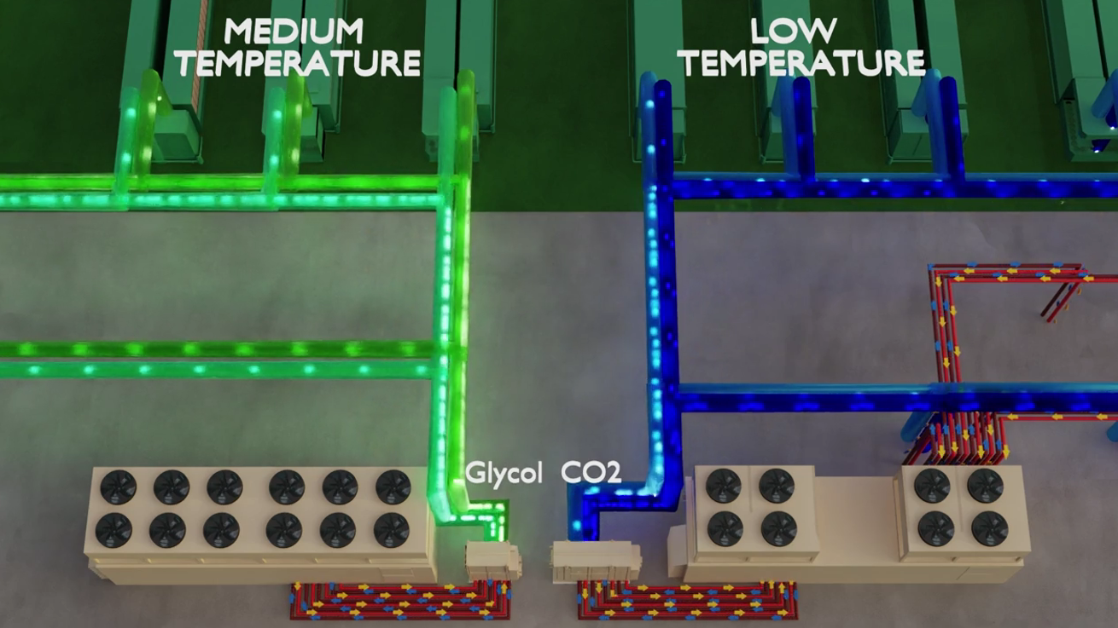
Utilizing existing equipment so it is familiar and cost effective
Existing equipment is phased out with natural end-of-life use.

Slide 22
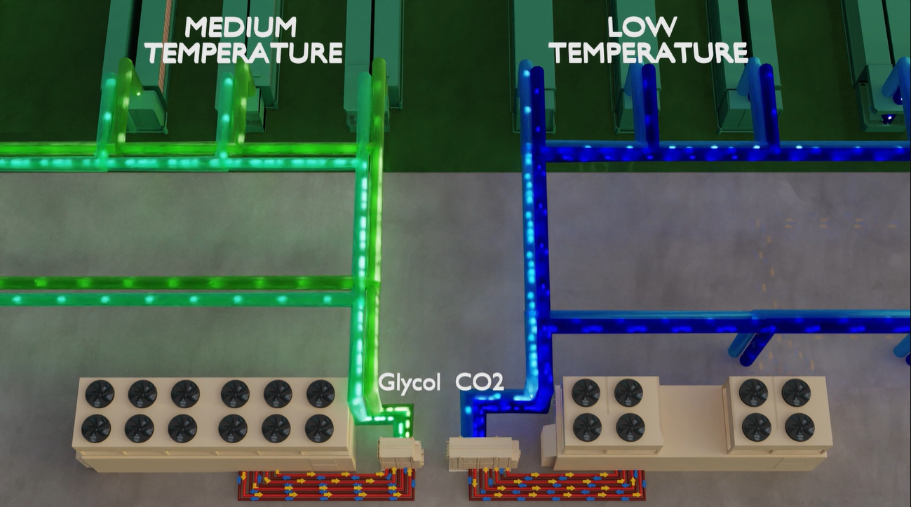
How does it work?
Pumped fluid is sent to cases rather than HFC refrigerants, reducing refrigerant
volume by 90%+

Slide 23
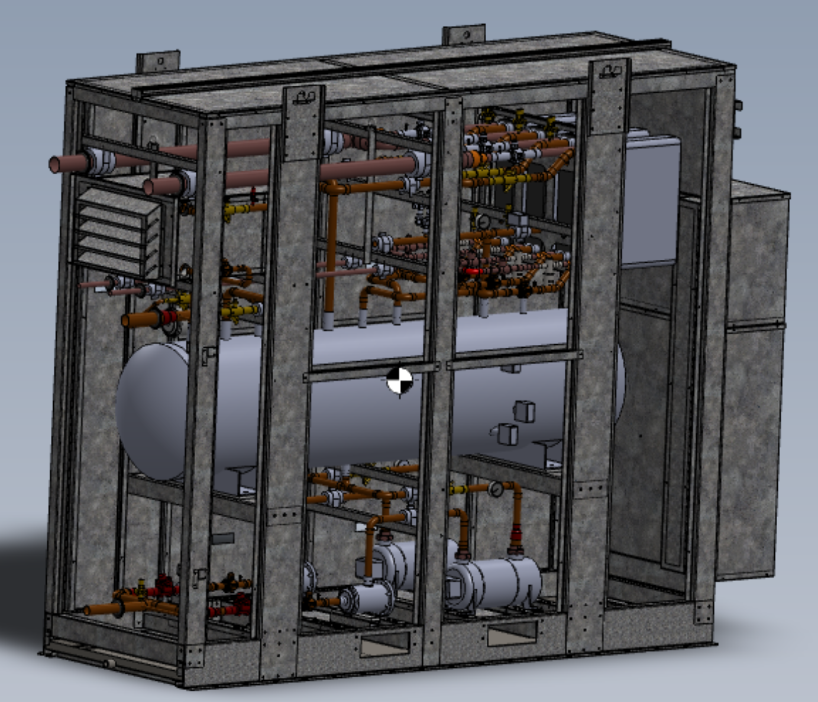
Secondary CO₂
Used for low temperature cases/freezers
  -20°F design supply fluid temperature.
  6°F design approach (R448a).
    Ex. -20°F leaving fluid requires -26°F suction temperature.
  Typical case temperature of -2°F to -12°F
Single Skid Size
  WMT-SEC-CO2-1-10

Slide 24
Design Temperature, Flow and Capacity Range

Slide 25
Walmart is using beverage grade CO₂
We have found that moisture content between refrigerant grade CO₂ and beverage grade CO₂ is negligible in the formation of carbonic acid. Typically, carbonic acid formation is due to a poorly evacuated system
Charging antacid drier and antacid drier in main line

Slide 26
CO2 Pumps
Utilize regenerative turbine pumps
Low NPSH requirement
Better at handling entrained vapor
CO2 pumps do not need oil due to a chrome oxide coating

Slide 27
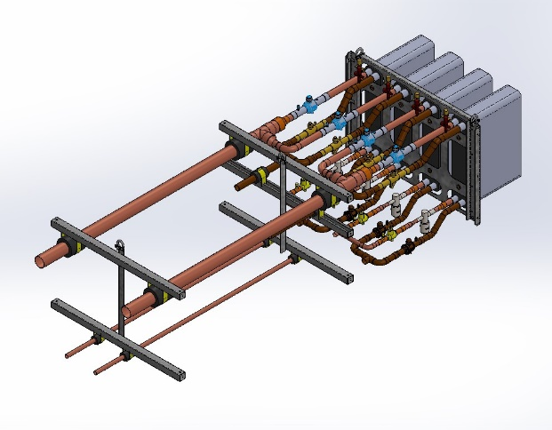
Four individual brazed plate heat exchangers for capacity control
Only two refrigerant circuit connections
Four EEVs per skid for turndown
Two dual valve EEV drivers

Slide 28
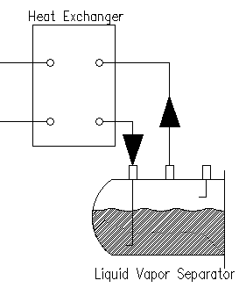
Thermosiphon
Liquid vapor separator paired with HX’s that act as a thermosiphon.
-26°F R448a
-20°F CO₂
Notes:
Discuss the importance of 2:1 overfeed

Slide 29
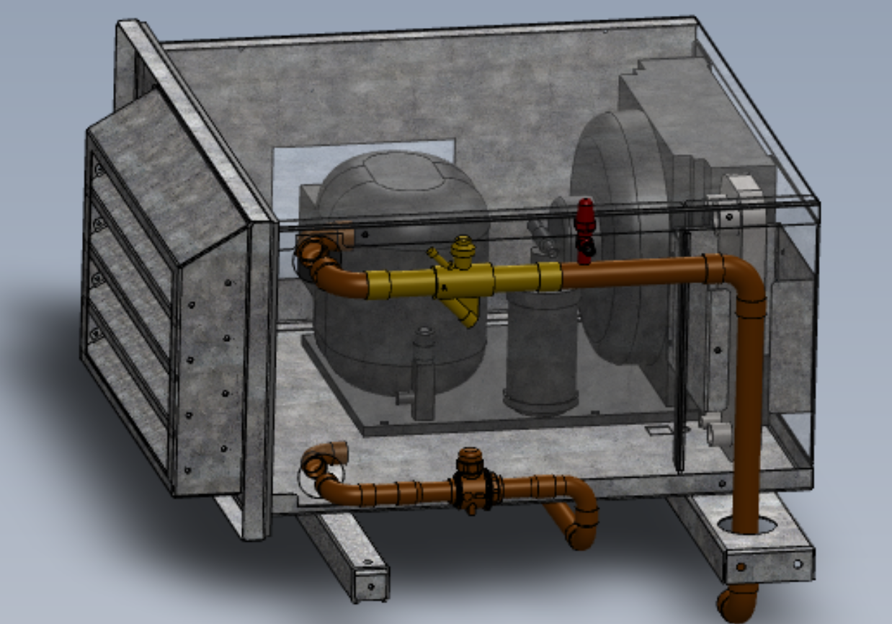
Loss of Charge Design Features
60 BAR Design
(Currently 45 bar PRV)
ECU (Emergency Condensing Unit)
  Comes on at 28 bar via Carel output
  Comes on at 40 bar through mechanical pressure switch
  Powered by UPS that is connected via
  a 230V power source in the store. Batteries and Inverter located inside
  the stores.
  Factory charged and tested with
  R448a

Slide 30
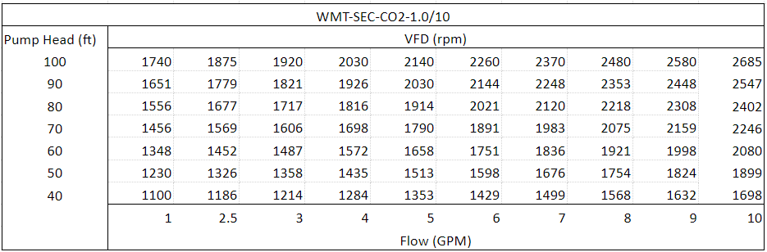
Flow Control
Fixed speed pumps with VFDs for setting flow
Fixed position bypass line mounted on the skid
2:1 overfeed rate

Slide 31
Refrigerants
Designed for R448a, but compatible with R404a/R407a at reduced performance
We are Wind and Snow Certified for the continental US
  Wind speeds up to 175 mph and snow loads up to 100 psf
R448a
R404a
R407a

Slide 32
END OF APPLICATION: CO₂

Slide 33
CONTROLS: CO₂

Slide 34
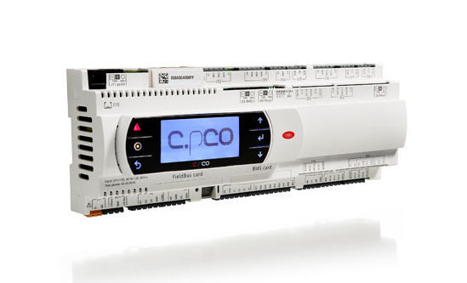
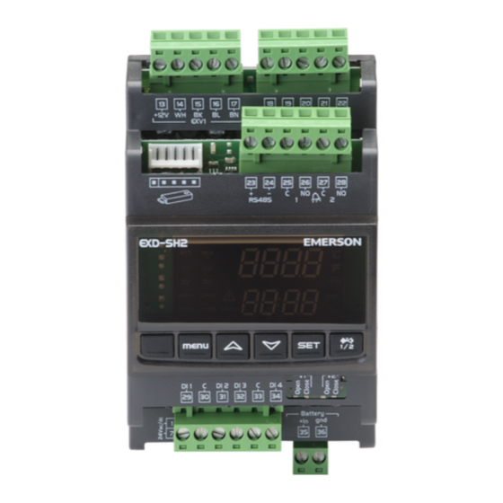
BACnet/IP to Store Network or Supervisor
Modbus RTU – RS485
<-EEV Position
<- Pressure
<- Temperature
<- SST
<- Superheat
Superheat Setpoint->
Carel CpCO
Emerson EXD-SH2
Digital Inputs
  Enable Switch
  Pump VFD Fail (per pump)
  Separator Level Switches - 15%, 35%, 85%
  Separator High Pressure Switch
Outputs
  Pump VFD Enable
  EEV Enable
  Auxiliary Condensing Unit Command
  Pump Speed 0-10V
Analog Inputs
  Rack-side Suction Pressure and Temperature
Analog Inputs
  Separator Pressure
  Pump Discharge Pressure
  Return/Inlet Fluid Temperature
  Supply/Outlet Fluid Temperature

Slide 35



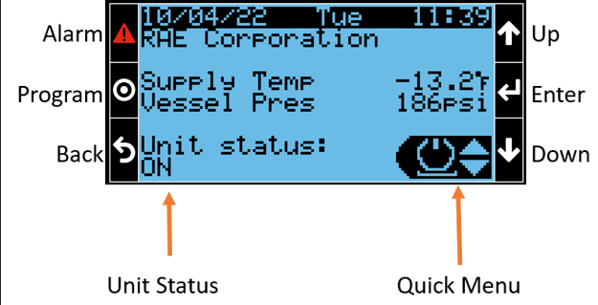

Menu Navigation [1.0]
Quick Menu
  Power
  Pump Variables
  Evaporator Variables
  Controller info
Notes:
Alarm Button – view current alarms. Go to end of loop and press Enter to view alarm history, or hold Alarm for 3 seconds to reset all alarms
“Program” aka menu button – access main menu
Quick menu – cycle through icons power, pump, evaporator, info
variables – all status info relating to pump/evaporator, requires no password. Some setpoints may be shown but are not changeable
Info – controller OS and software version, store number and rack assignment, etc
Power – “off by keyboard”, a virtual enable switch

Slide 36
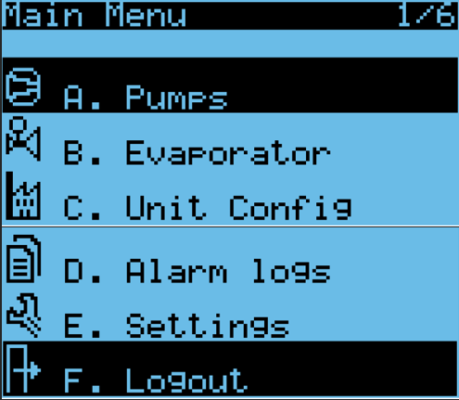
Menu Navigation [1.1]
Main Menu
  Pump Parameters
  Evaporator Parameters
  Unit Configuration
  Settings
Notes:
Password Protected
Parameters – any changeable, stored parameter or setpoint
Unit Config – initial setup, IO configuration and overrides
Alarm Logs – same alarm log accessed from the alarm menu
Settings – Modbus and BACnet communication settings and status

Slide 37
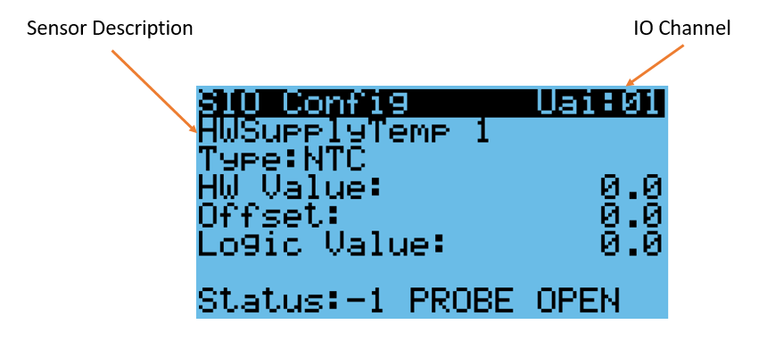
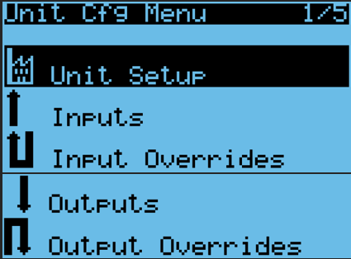
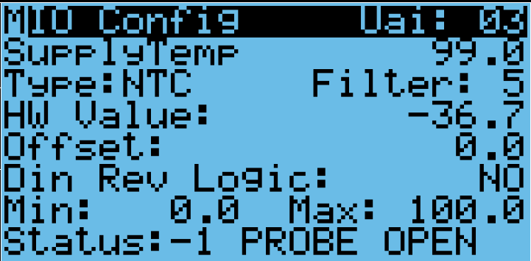
Menu Navigation [1.2]
Unit Configuration
Notes:
Initial setup (store number, rack assignment, refrigerant type)
Inputs can help troubleshoot an input problem
Output overrides can verify operation of a connected output

Slide 38
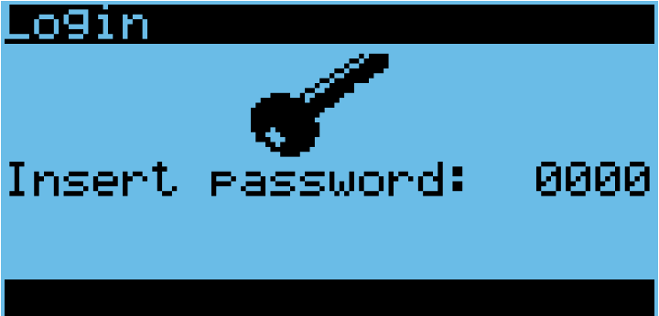
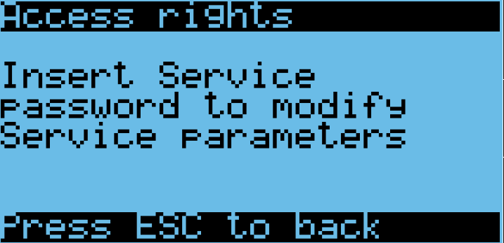
Menu Navigation [1.3]
Login
User: 0001
  Can view all screens but can only make changes to setpoints
Service: 0002
  Can change all setpoints, parameters, comms settings, but not deep level configuration
Manufacturer
  Can change all
Controller will tell you what level is required if you aren’t logged in at or above that level

Slide 39
Sequence of Operation [1.0]
Pump
  The following MUST be true to enable pump operation:
    Enabled by switch AND controller keypad
    Proof of compressor operation via rack suction pressure
    At least one (1) pump VFD must be powered and in a non-fault state
    CO2 Liquid-Vapor Separator (LVS) Pressure and Level criteria satisfied
  High rack-side suction pressure is indicative of a disabled rack
    Cut-out (SST = 0°F) and Cut-in (SST = -5°F)
  Rack side suction pressure is read via communications with the EEV controller. Total comm loss or failure of all four suction transducers will disable refrigeration.

Slide 40
Sequence of Operation [1.1]
Pump
  Separator Pressure
    Pump disabled < Low Separator Pressure (LVP) Cut-out (150psig), enabled > Cut-in (160psig)
    Pump disabled if Separator pressure > High Pressure cut-out (325psig), enabled < cut-in (300psig)
  Separator Liquid Level
    Pump disabled if liquid level < 15% for 5 minutes.
    Re-enable when liquid level exceeds 15%
  Pump Rotation
    Proof is determined by differential between Separator pressure and pump discharge pressure
    Will alarm and rotate to lag pump after 30 seconds without flow
    Rotate lead/lag weekly

Slide 41
Sequence of Operation [1.2]
Refrigeration
  The following must be true to enable refrigerant circuit operation:
    Enabled by switch AND controller keypad
    Proof of compressor operation via rack suction pressure
    LVS pressure criteria satisfied

Slide 42
Sequence of Operation [1.3]
Staging
  EEV 1a will stage to maintain saturation temperature in the Separator within a 4ºF band centered on the Separator saturation temperature setpoint.
  Enable additional circuit if all active EEVs are at least 95% open for 30 seconds.
  Disable one circuit if all currently active EEVs are less than 50% open for
  30 seconds.
  Interstage delay timer required between EEV/superheat based staging activity. ALL circuits will be disabled if the LVS saturation temp falls below the LVS saturation temperature setpoint, minus the differential to stop (2ºF).
  An EEV is unavailable due to communications, sensor, or value motor fault, the next available circuit will be utilized.

Slide 43
Emergency Condensing Unit
Enable:
  Via pressure switch if the Separator pressure reaches 40 bar
  Manually via the controller display (to aid in charging)
  Automatically (via controller) if separator pressure exceeds 28 bar

Slide 44
Alarms
Automatic Reset
  Sensor Failures
    Separator Pressure
    Pump Discharge Pressure
    Supply/Outlet Temperature
    EEV Controller Suction Pressure and Temperature
  EEV Controller Offline
  Pump VFD Fault
  Pump flow (per pump, 30 seconds of no flow)
  Separator Level (>85%, <35%, <15%)
  High supply temperature
  Separator Pressure (high or low)
  Low Superheat
  Rack Disabled (high suction pressure)
User Reset
  Freeze (low suction pressure)
  Pump flow (general, 5 minutes of no flow)

Slide 45
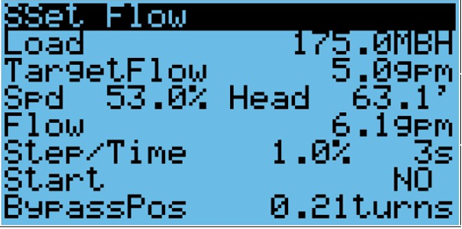
Setting Flow
Automatic Flow Setting Routine
Start with warm cases/walk-ins, close bypass and force all loads "On"
Navigate to Flow Set screen, enter design MBH of the cases tied to secondary skid, and change "Start" to "Yes".
Controller will start at minimum speed and slowly increase. Wait for "Start" to go from "Yes" to "No".
Set bypass valve to the position noted on the screen (turns from "Closed")

Slide 46
END OF CONTROLS: CO₂

